Slide 1
Applications of Information & Communication Technology
Mr. Ali Haider
Institute Of Management Sciences

Slide 2
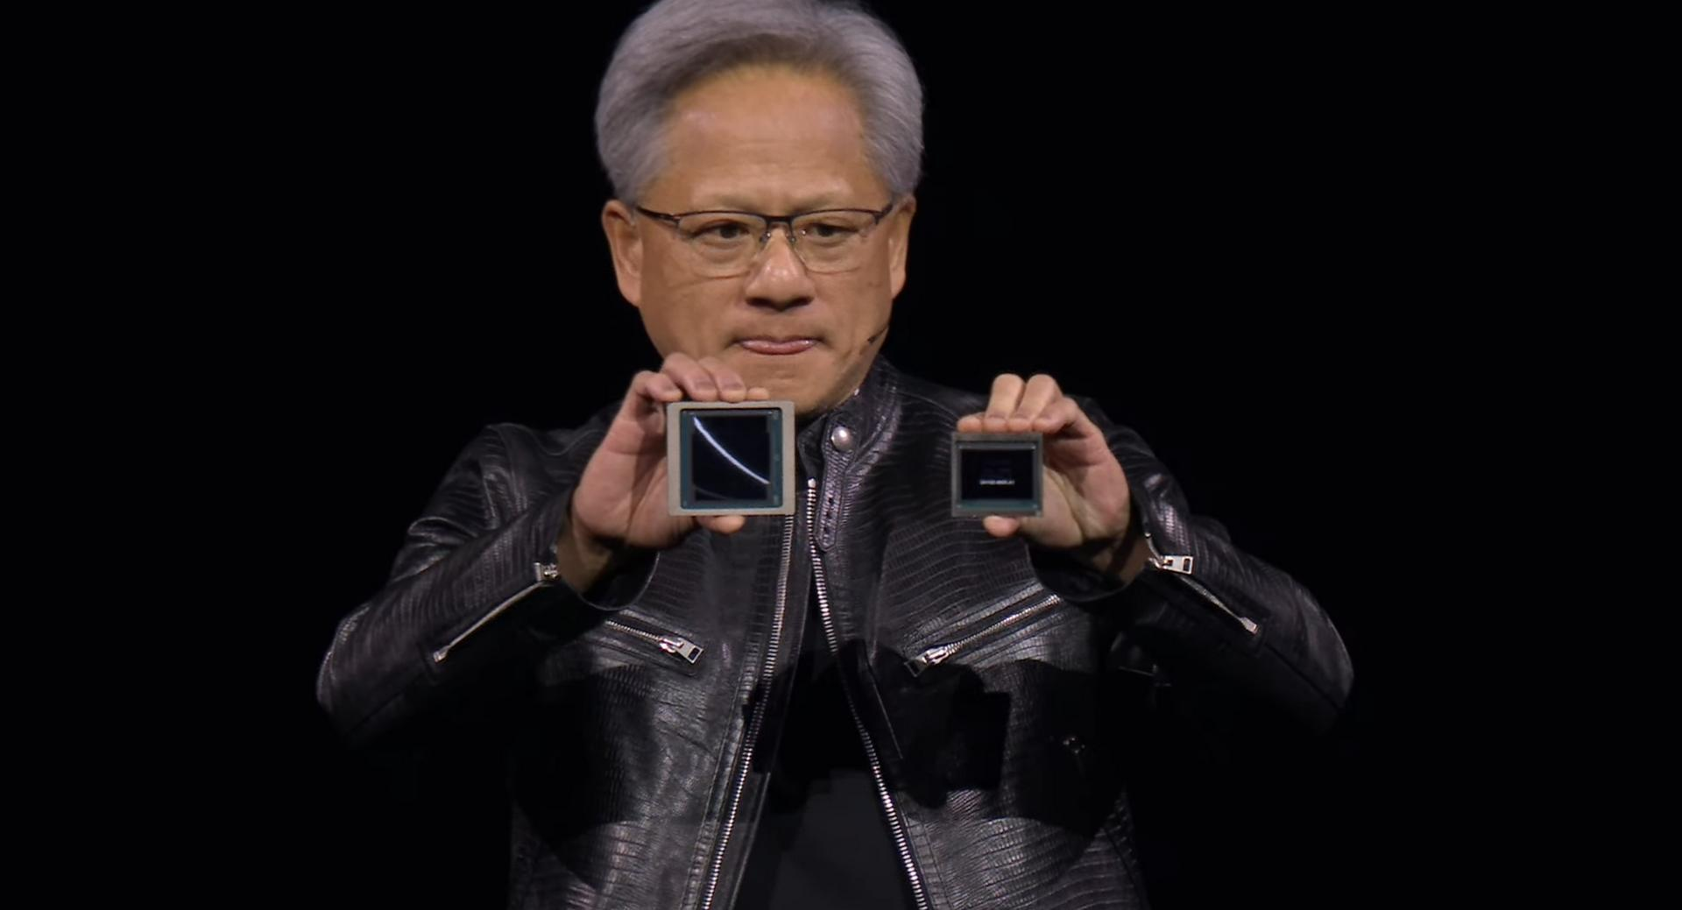
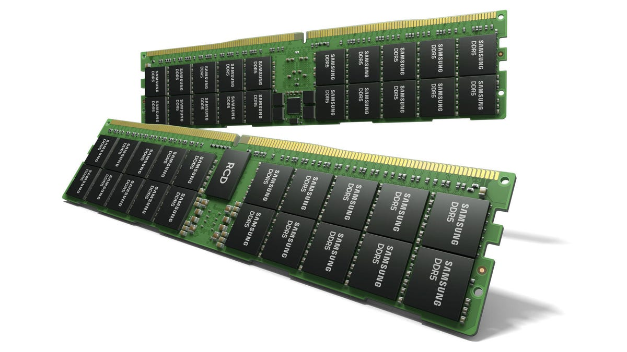
March 19 - Chip designer Nvidia's (NVDA. O) , opens new tab latest "Blackwell" B200 artificial intelligence chip will cost between $30,000 and$40,000, CEO Jensen Huang
208 billion transistors.
512 GB RAM
Designed for high-performance computing environments such as data centers and enterprise servers.
CPU VS GPU :
https://youtu.be/-P28LKWTzrI?si=9Qwts1aV29sW4uBI

Slide 3
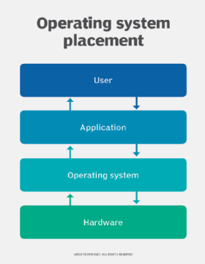
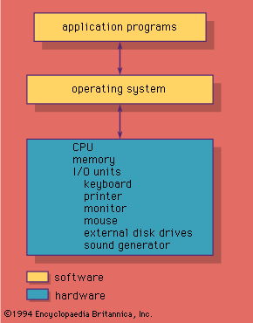
OPERATING SYSTEM

Slide 4
O.S. vs BIOS
BIOS:
Firmware responsible for initial hardware setup and booting the OS. It operates before the OS is loaded.
OS:
Software that manages hardware resources, provides a user interface, and runs applications. It operates after the BIOS has handed over control.

Slide 5
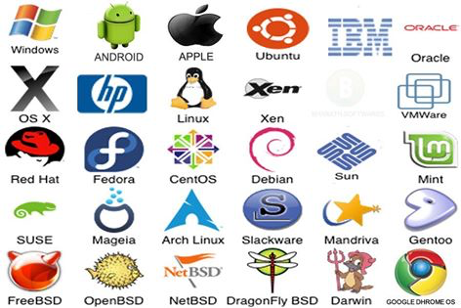
O.S. in the World

Slide 6
Windows:
Microsoft.
Bill Gates.
The source code for Windows is not publicly available
Mac OS
Apple
Steve Jobs.
The source code for Mac OS is not publicly available
Linux OS
Different Flavors: Ubuntu, Kali linux, Arch, Mint etc
Linus Torvalds in 1991.
The source code for Linux is publicly available

Slide 7
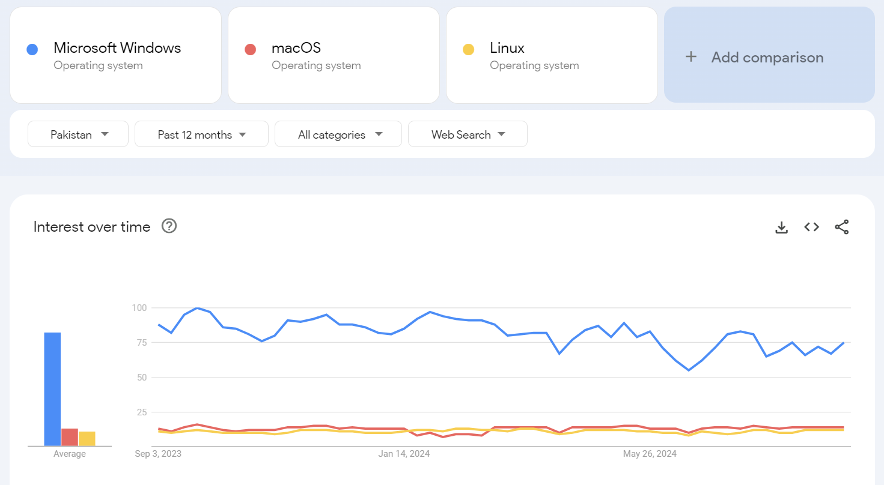

Slide 8
Installation
Windows 10:
https://youtu.be/3hUQSAIxlJo?si=EHFoN94wJ0I-gt_2
Mac OS:
https://youtu.be/BRqFtjJY9gU?si=6dQiP5U0OFkMDsfH
Linux:
Ubuntu: https://youtu.be/C5deqtXrpgk?si=i9o4qr2APJmgjxv9
Kali Linux: https://youtu.be/N8OqyMfB2nA?si=tsI5JpsFfaMvxrTS

Slide 9
Windows Basic Configuration & Setup
Initial Setup
Power On and Installation
Product Key
License Agreement
Installation Type
Partitioning
Installation Process
2. First-Time Setup
Region and Language
Keyboard Layout
Network Connection
Microsoft Account
Privacy Settings
Windows Updates

Slide 10
3. Basic Configuration
Desktop Customization
System Settings
User Accounts
Security Settings
Backup
Software Installation
Accessibility Features
4. Maintenance and Updates
Check for Updates
System Cleanup
Performance Monitoring

Slide 11
Control Panel
User Accounts
Computer Management
Device Manager
Hostname

Slide 12
Thank You.
The End

